Slide 1
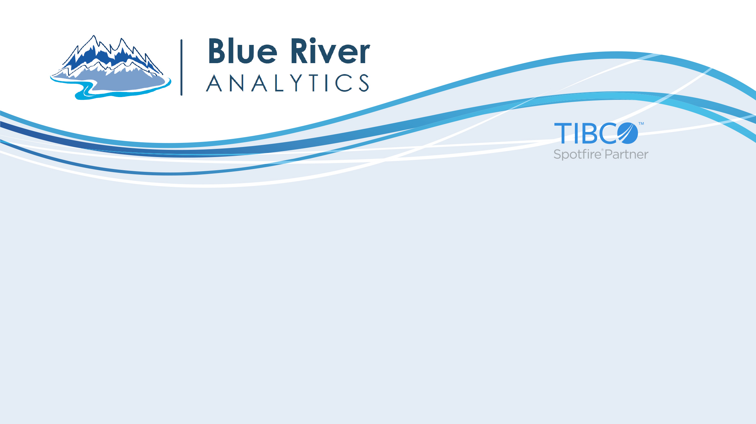
Agile Analytics
Andy Lathrop| Analytics Director, Blue River Analytics
June 17, 2015

Slide 2

Business Agility
Employees down in the trenches, in individual business units, are the ones who are in close touch with customer problems, market shifts, and process inefficiencies.
These workers are often in the best position to understand challenges and opportunities and to make decisions to improve the business.
It is only when responses to change come from within … that enterprises become agile, competitive, and successful.
-Forrester Wave: Agile Business Intelligence Platforms, Q3 2014

Slide 3
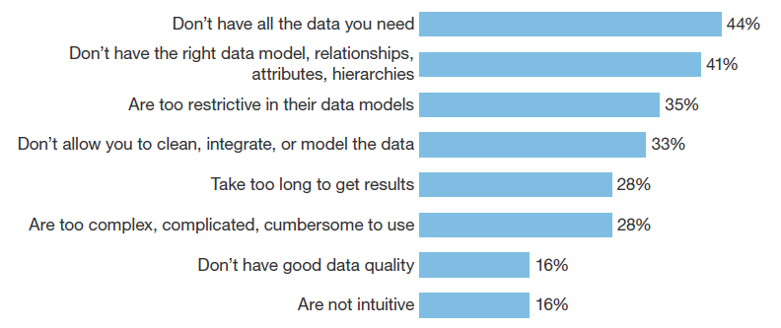
Top Creativity Killers (aka Production De-Optimization Capabilities)

Slide 4

Business Value of Analytics
With “better” analytics
5X more likely to make decisions faster than peers
3X more likely to execute decisions as planned
2X more likely to be in top quartile of financial performance
Improve production 6-8%
(2014 Bain survey)
Only 4% have analytics capabilities to deliver tangible business value

Slide 5
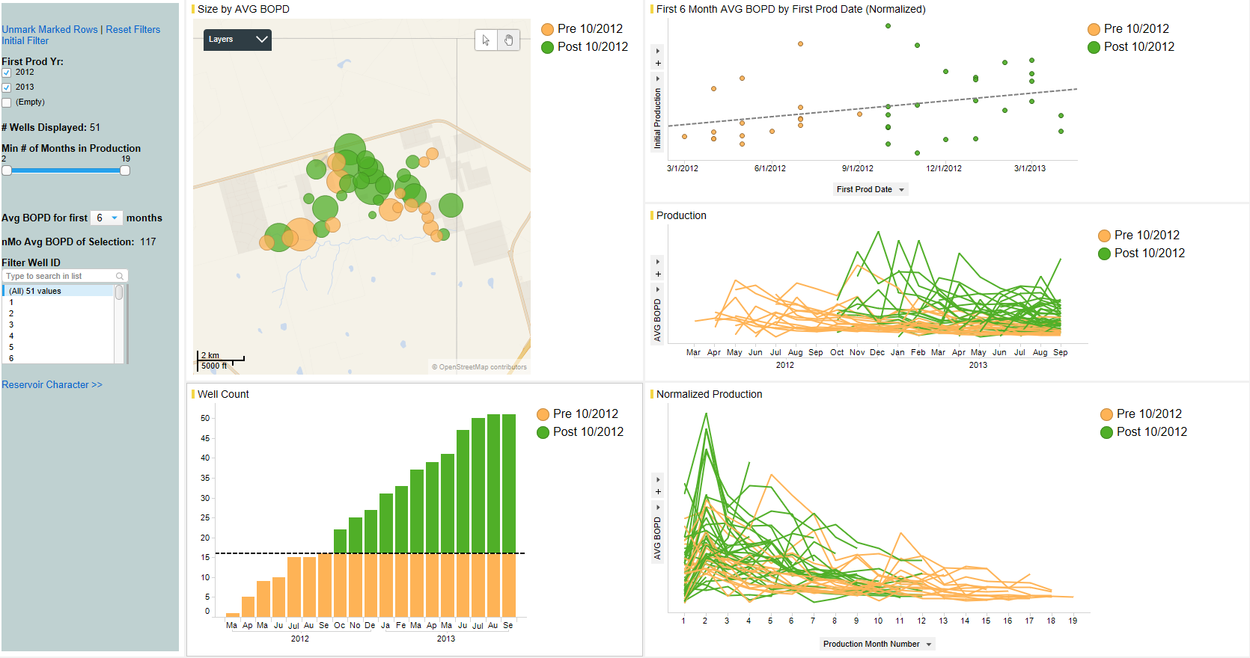
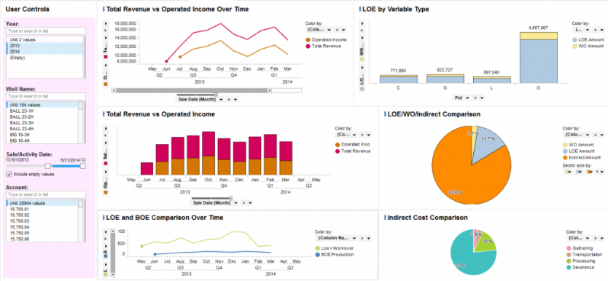
Components of an Agile Analytics Platform
Self-provisioning Applications and Data
Connect to new data sources
Drill anywhere
Mobile delivery
Data Mashup and Wrangling
Multiple data sources in one view
Calculated measures
Light weight data cleanup
Effective User Interfaces
Business users create own reports and dashboards
Guided navigation
Breadth of Analytics Capabilities
Advanced data visualization (geospatial, autosuggestions)
Advanced and predictive capabilities in addition to self-service discovery

Slide 6
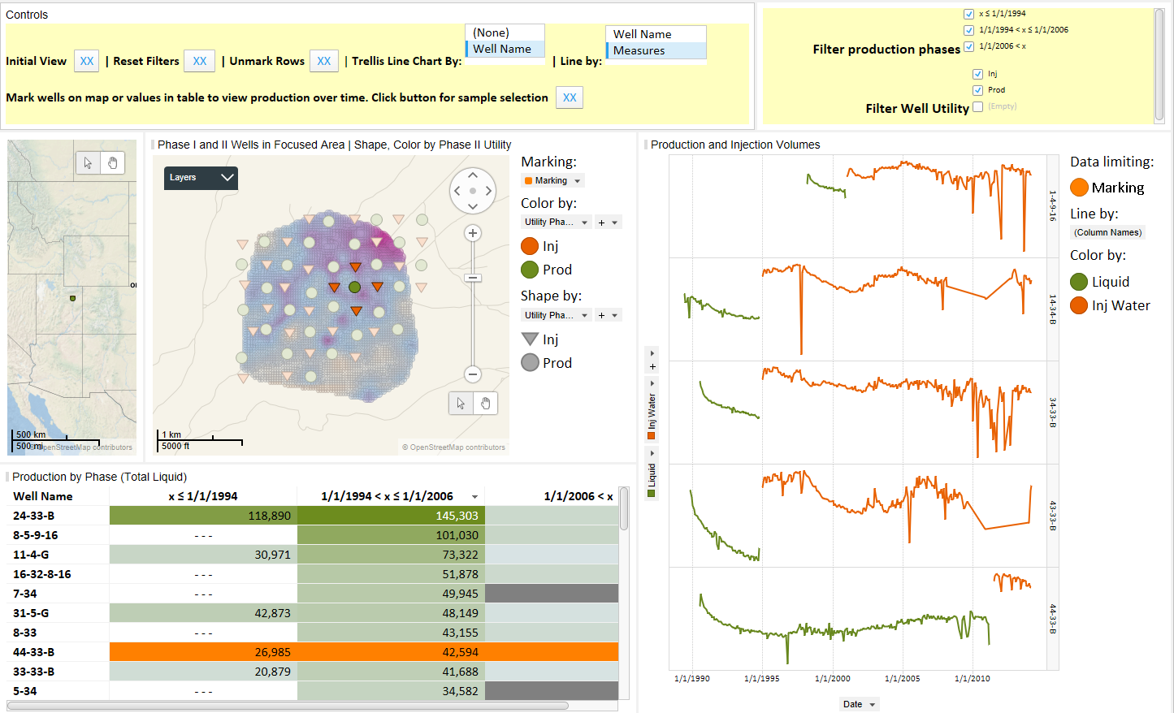
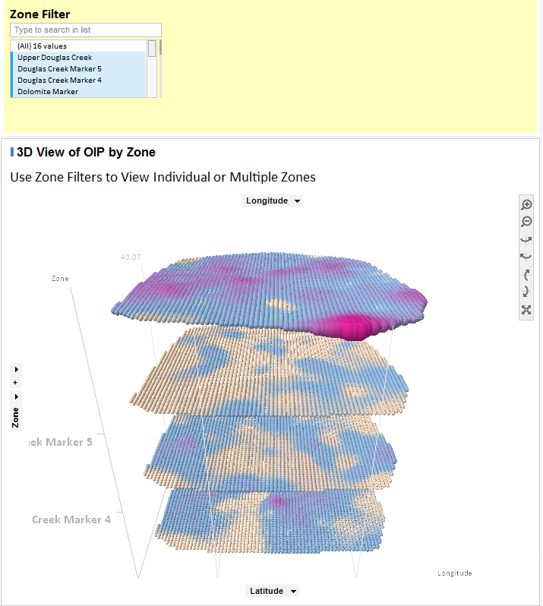
Agile Analytics in Action
Combined production and petrophysical data for a multi-dimensional view of reservoir behavior

Slide 7
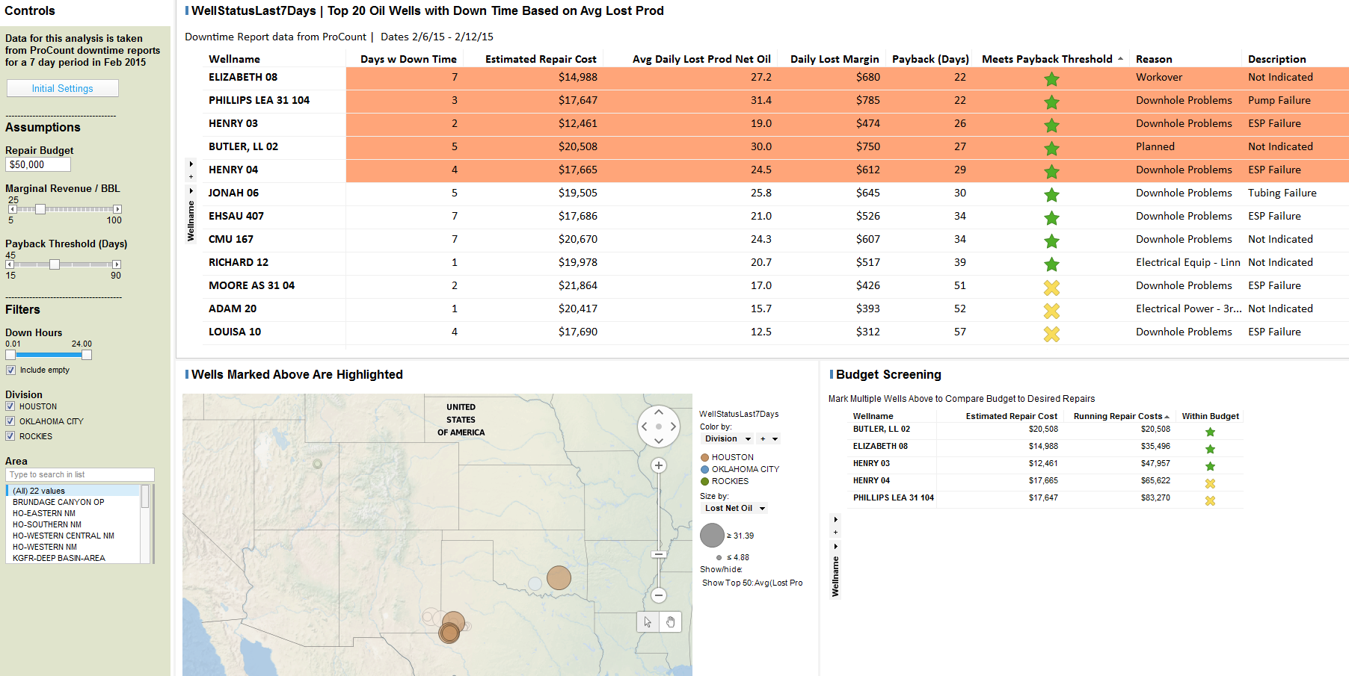
Agile Analytics in Action
Failure tracking and analysis | Rapid prototyping | Scenario analysis

Slide 8
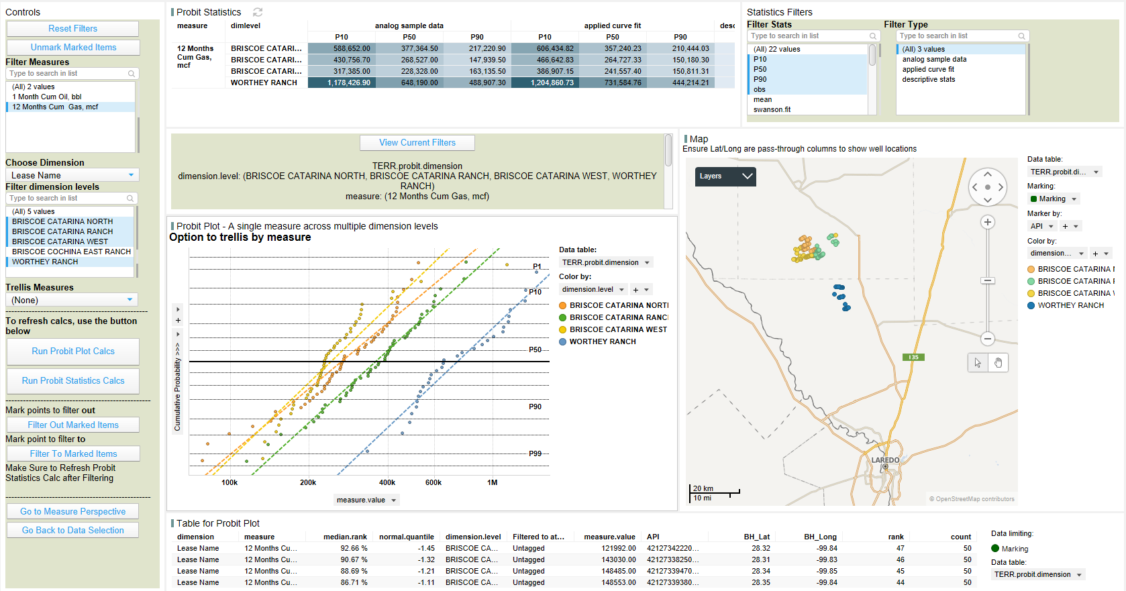
Agile Analytics in Action
Probability plotting using R and an intuitive interface

Slide 9
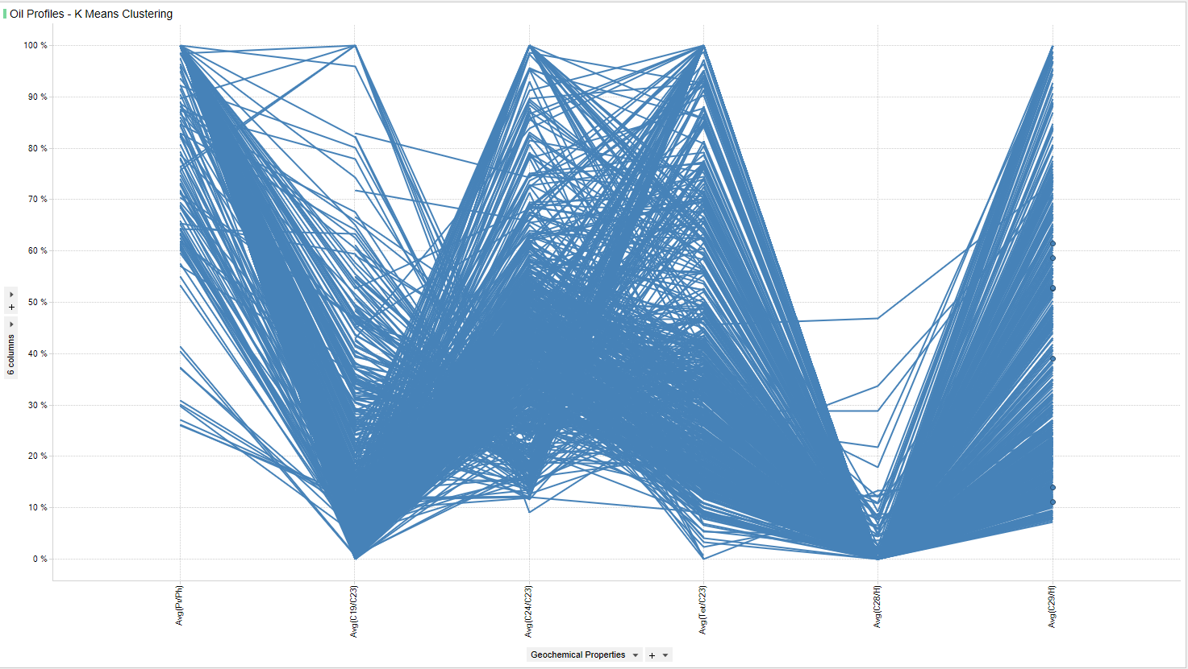
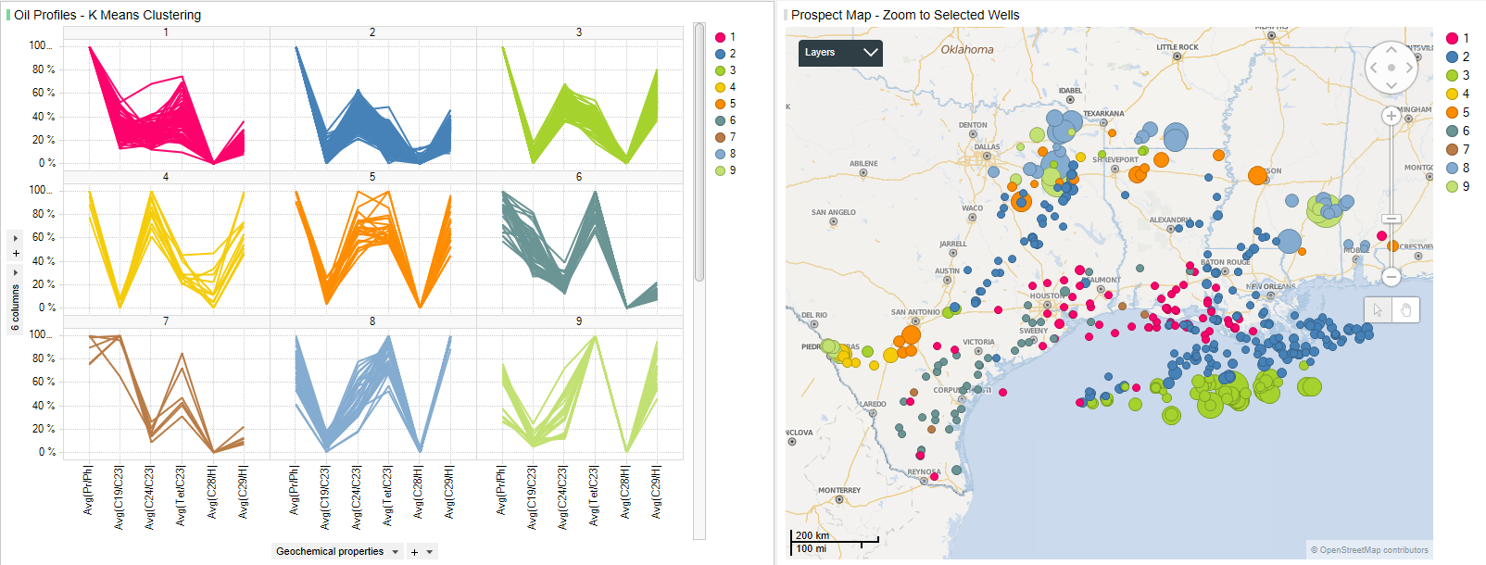
Advanced Analytics
Pattern recognition using data science techniques

Slide 10
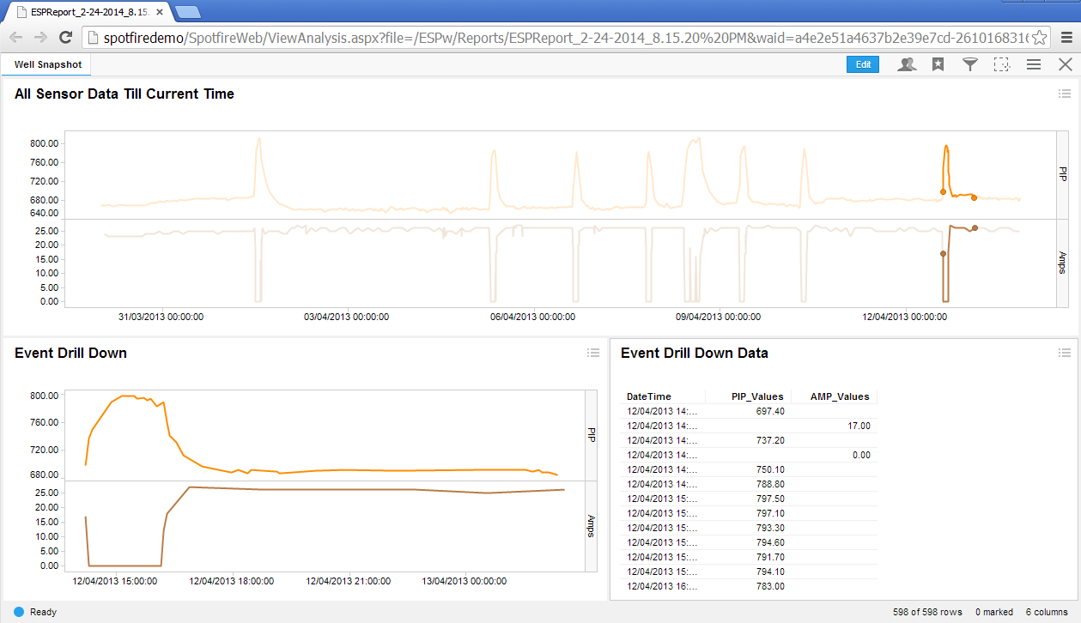
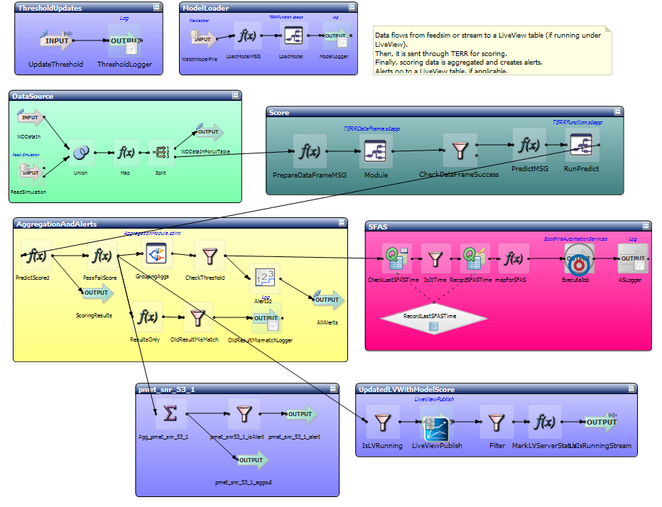
Advanced Analytics
Other data science techniques for production optimization
Hierarchical clustering
Regression
Fuzzy Logic / Association Rules
Neural Networks
Time Series Analysis
Trap for patterns in Pump Pressure and Current: opposite first derivatives
PRESSURE CURRENT
PRESSURE CURRENT

Slide 11
Andy Lathrop| Analytics Director, Blue River Analytics
andy.lathrop@blueriveranalytics.com
blueriveranalytics.com

Slide 12
Search terms
Forrester:
The Forrester Wave: Agile Business Intelligence Platforms
The Forrester Wave: Enterprise Business Intelligence Platforms
The Forrester Wave: Big Data Predictive Analytics Solutions
Gartner:
Magic Quadrant for Business Intelligence and Analytics Platforms
Magic Quadrant for Advanced Analytics Platforms

Slide 13
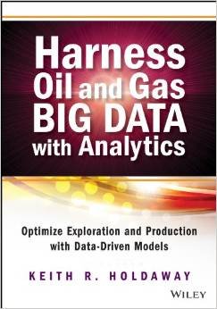
References
Holdaway, Keith. Harness oil and gas big data with analytics: Optimize exploration and production with data driven models.
Amazon link: http://www.amazon.com/Harness-Oil-Gas-Data-Analytics/dp/1118779312
Big Data analytics in oil and gas. (n.d.). Retrieved June 13, 2015, from http://www.bain.com/publications/articles/big-data-analytics-in-oil-and-gas.aspx

